Slide 1


IST 659 Project Presentation
Make the best movie
Group Members: Andrew Matejcik, David Eister, Jordan Dubreil

Slide 2
Business case
Our team has been tasked with creating a tool for major movie studios to help get butts into seats for the movies!
The database will help in assisting the studios create the best formula to generate income and garner publicity to help get people to see the movie.
The goal is to be able to mix and match Actors, directors and composers into combinations that help generate the most income and cost the least

Slide 3

Database criteria
This database holds the information for the following:
  Actors
  Directors
  Composers
  Movies
  Earning reports
  Awards

Slide 4
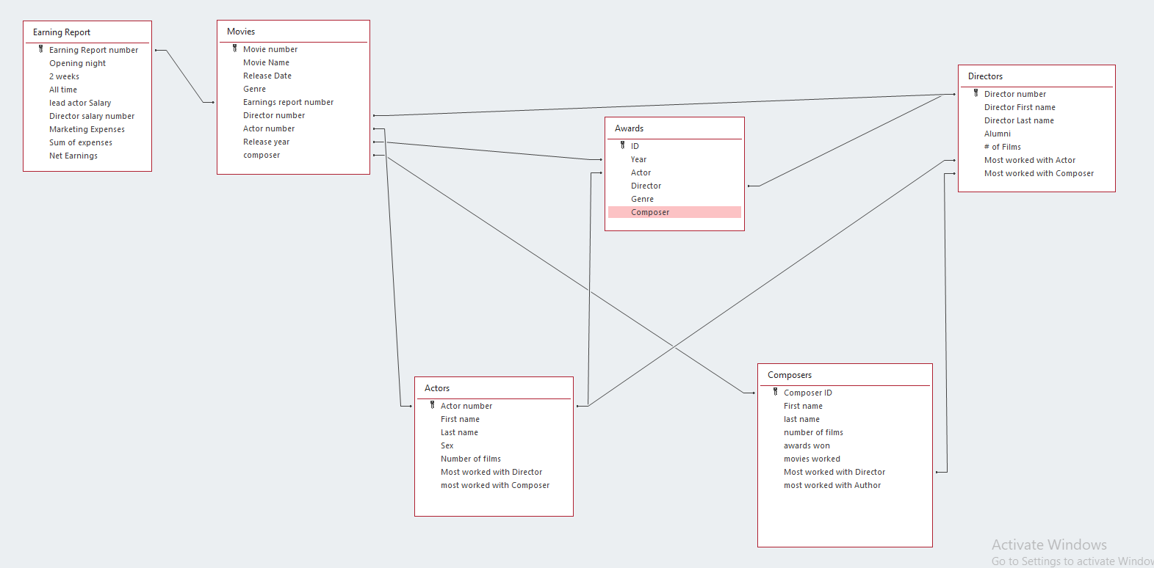
Logical Model

Slide 5
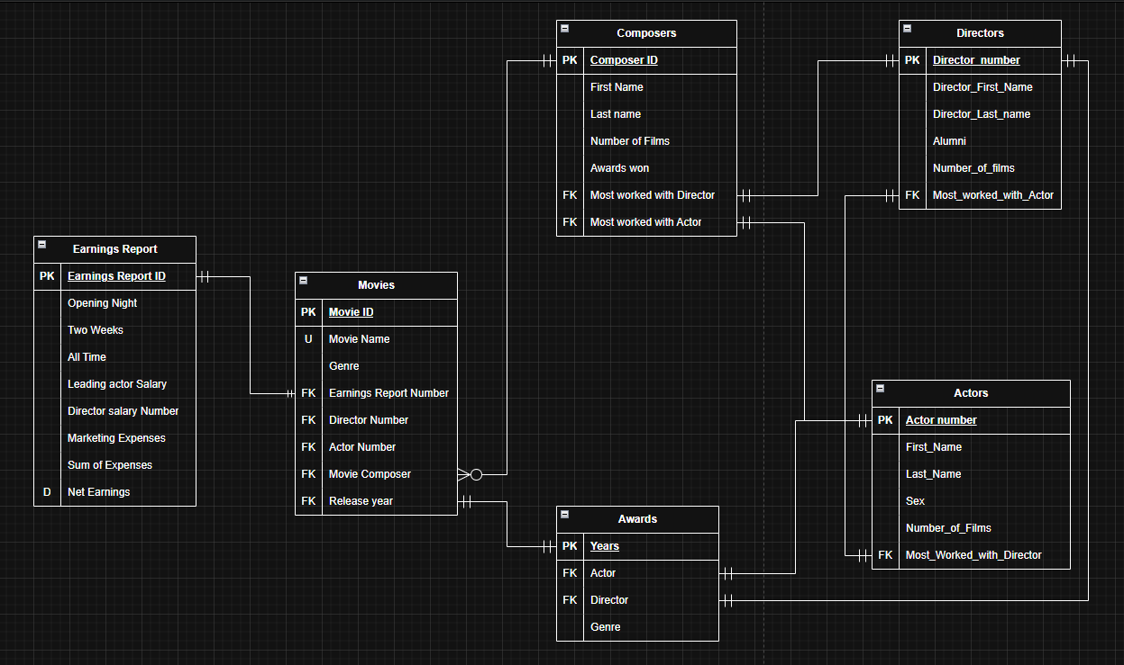
Database ERD

Slide 6
Database Relationships
Movies ↔ Earnings Report
  One Earnings Report links to one Movie (via Earnings Report Number).
  Relationship: 1:1 or 1:N depending on reporting structure.
Movies ↔ Directors
  Each Movie has one Director.
  A Director can direct many Movies.
  Relationship: 1:N.
Movies ↔ Actors
  Each Movie has one Actor (lead?).
  An Actor can be in many Movies.
  Relationship: 1:N.
Movies ↔ Composers
  Each Movie has one Composer.
  A Composer can score many Movies.
  Relationship: 1:N.
Actors ↔ Directors
  Stored via “Most Worked With” attributes.
  Relationship: M:N but simplified into FK attributes
Composers ↔ Directors
  A Composer can have a "Most Worked With Director".
  Relationship: 1:1 or N:1.
Composers ↔ Actors
  A Composer can have a "Most Worked With Actor".
  Relationship: 1:1 or N:1.
Awards ↔ Actors/Directors
  Awards table references both Actors and Directors (plus Genre and Year).
  Relationship: M:N resolved via Awards.

Slide 7
Data Questions and answers
Who are the top 3 directors in a given genre, by average net earnings?
Who are the top 3 actors in a given genre, based on their average net earnings across movies?
Who are the top 3 composers in a given genre, ranked by average net earnings?
What is the average director price (salary) over selected films, optionally filtered by director, genre, and release year range?”

Slide 8
Basic layout of all application screens/reports (inputs & outputs)
Inputs
Year range, Genre, Top-N, Include/Exclude talent.
Browse all films with key people and profitability.
Genre (single/multi), Year range.
Genre
Outputs
Avg Earnings, Avg Expenses, Avg ROI, #Movies
Movie, Year, Genre, Director, Actor, Composer, Net_Earnings, Expenses, ROI
Movie, Net_Earnings, Avg_All, Avg_By_Genre, Delta_to_Genre
Name, Movies_Count, Avg_Earnings

Slide 9
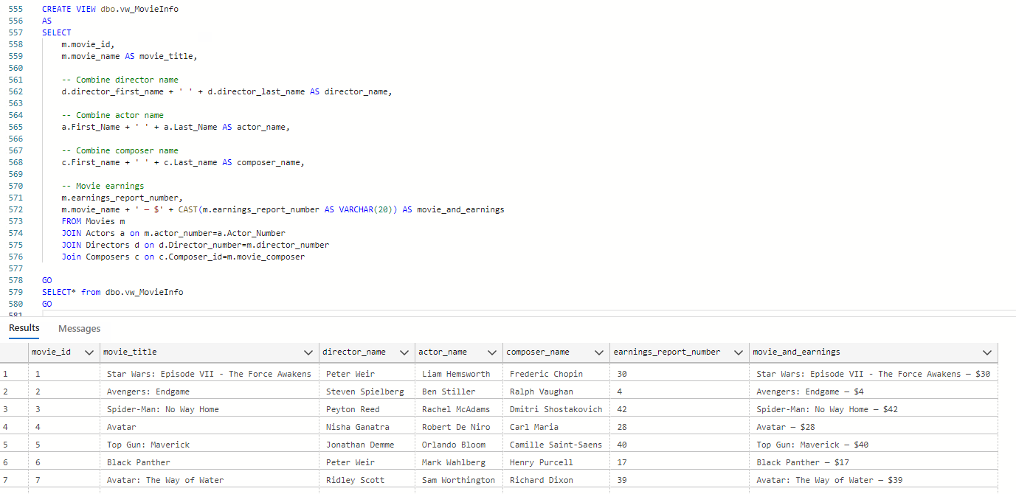
Examples on how on how to use the database for business case

Slide 10
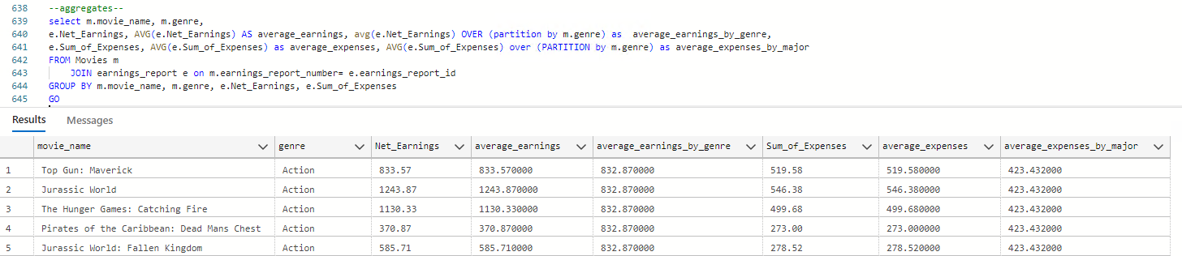
Examples on how on how to use the database for business case

Slide 11
Examples on how on how to use the database for business case

Slide 12

Conclusion

